Slide 1
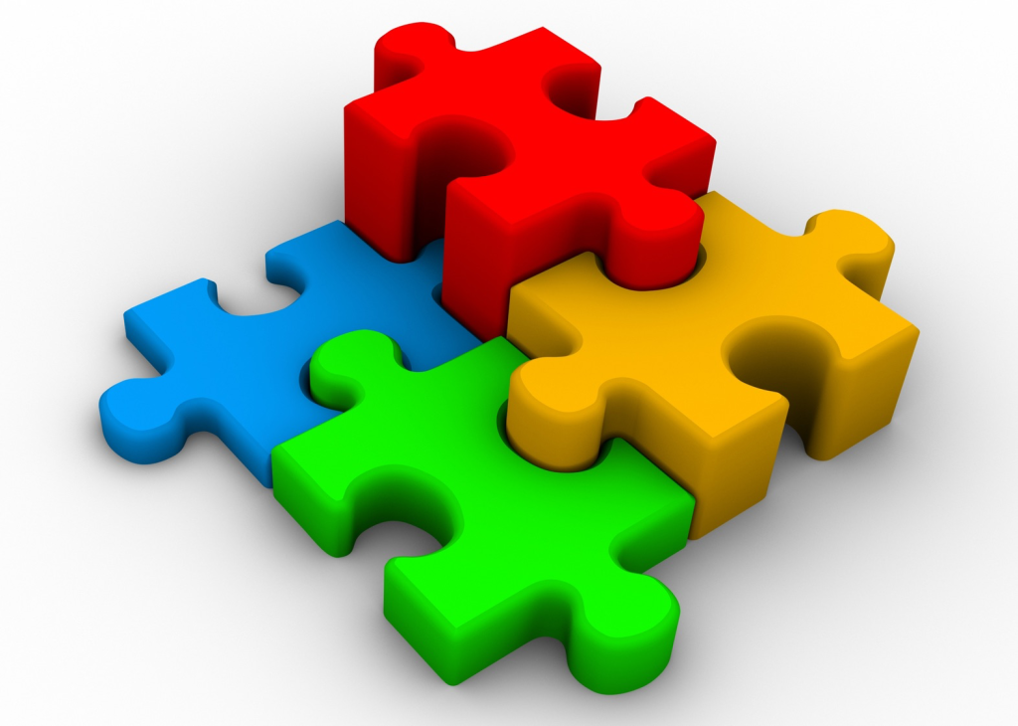
Composing software |> the functional way
by Radu Popovici – Oncica
with Liviu Frateanu

Slide 2
Agenda
Functional Programming paradigm
Category theory basics
F# language
Web server frameworks
Asp.Net MVC
Suave
Asp.Net Giraffe
Saturn

Slide 3
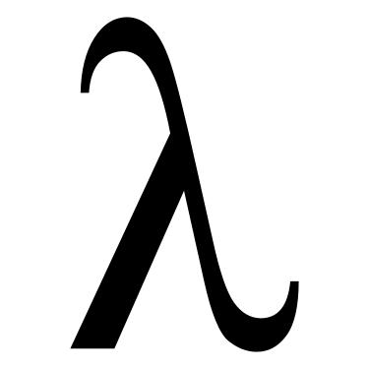
The FP paradigm

Slide 4
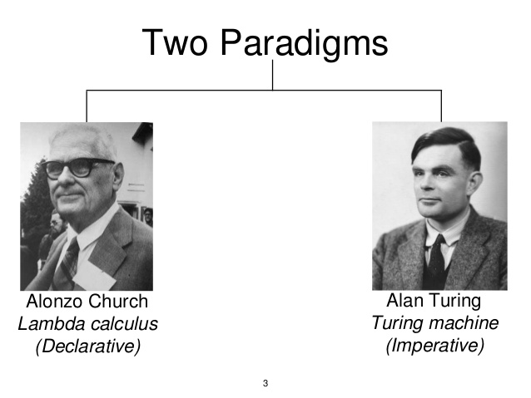
In the begging was the…
In the beginning of computer science, before most of computer science was actually done on computers, there lived two great computer scientists: Alonzo Church, and Alan Turing. They produced two different, but equivalent universal models of computation. Both models could compute anything that can be computed (hence, “universal”).
Together, they collaborated to show that lambda calculus and the turing machine are functionally equivalent.

Slide 5
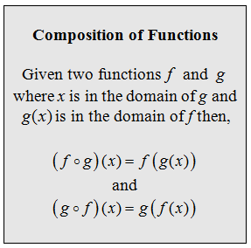
The lambda calculus
Lambda calculus is all about function composition. Thinking in terms of function composition is a remarkably expressive and eloquent way to compose software.
There are three important points that make lambda calculus special:
Functions are always anonymous.
Functions only accept a single input. They’re unary. If you need more than one parameter, the function will take one input and return a new function that takes the next, and so on. The n-ary function (x, y) => x + y can be expressed as a unary function like: x => y => x + y. This transformation from an n-ary function to a unary function is known as currying.
Functions are first-class, meaning that functions can be used as inputs to other functions, and functions can return functions.

Slide 6
What is the essence of software development? We can do it better…
Composing Software Components
All software development is composition: The act of breaking a complex problem down to smaller parts, and then composing those smaller solutions together to form your application.
If you’re a software developer, you compose functions and data structures every day, whether you know it or not. You can do it consciously (and better), or you can do it accidentally, with duct-tape and crazy glue.

Slide 7
FP = Composing software via function composition

Slide 8
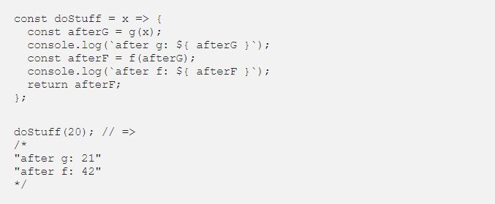
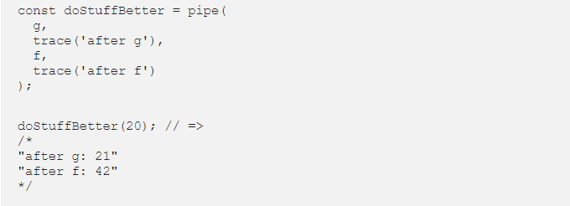
Composing Functions

Slide 9
OOP = Composing software via object composition

Slide 10
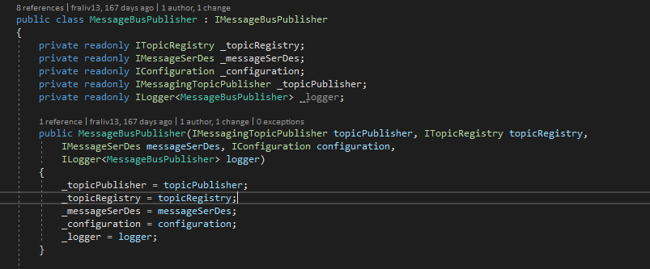
Composing Objects
“Object Composition Assembling or composing objects to get more complex behavior.” ~ Gang of Four, “Design Patterns: Elements of Reusable Object-Oriented Software”
“Favor object composition over class inheritance.” ~ Gang of Four, “Design Patterns”.

Slide 11
The Fall of Functional Programming
In 1972, Alan Kay’s Smalltalk was formalized, and the idea of objects as the atomic unit of composition took hold. Smalltalk’s great idea about component encapsulation and message passing got distorted in the 80s and 90s by C++ and Java into a horrible idea about inheritance hierarchies and is-a relationships for feature reuse.
Even though Smalltalk was a functional OOP language, when C++ and Java took over mindshare, functional programming was relegated to the sidelines and academia

Slide 12
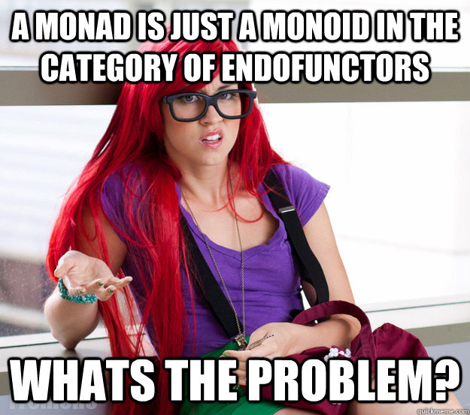
Notes:
Category theory give us, programmers, composition patterns

Slide 13
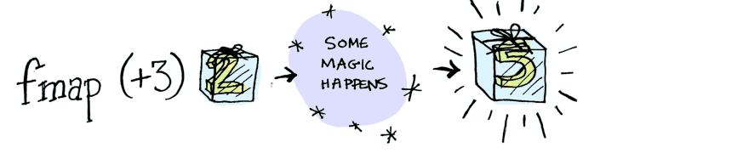
Functor
In math: a mapping between categories
In FP it’s a data type that can be mapped over

Slide 14
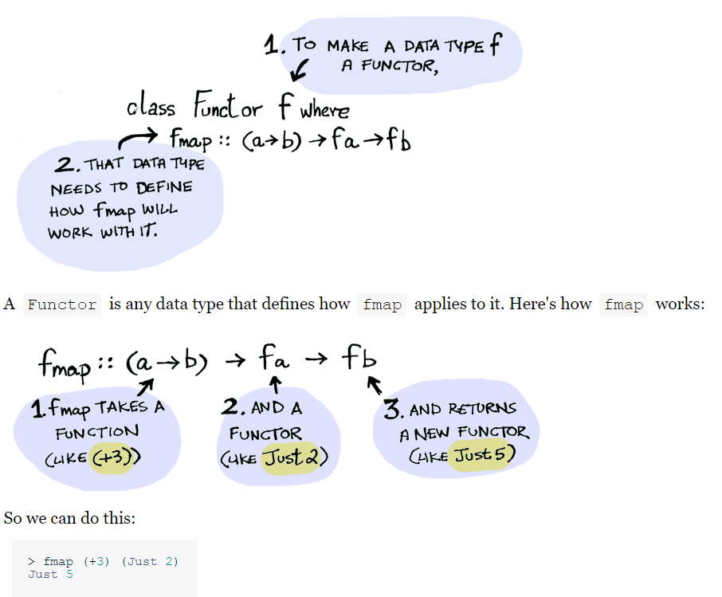

Slide 15
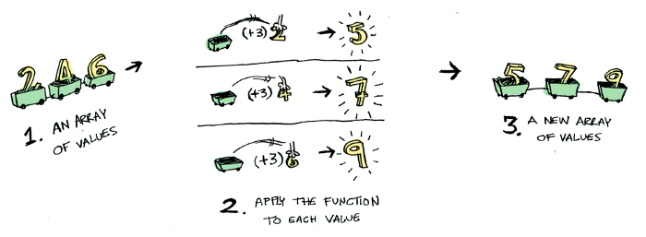
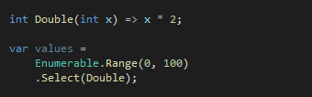
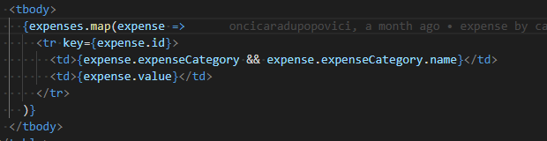
Enumerables (iterables) are functors

Slide 16


Slide 17
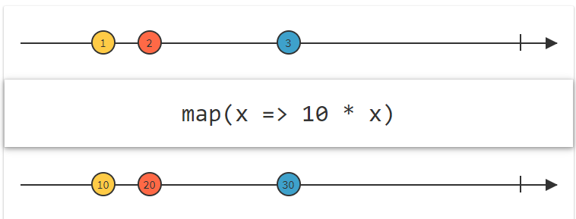
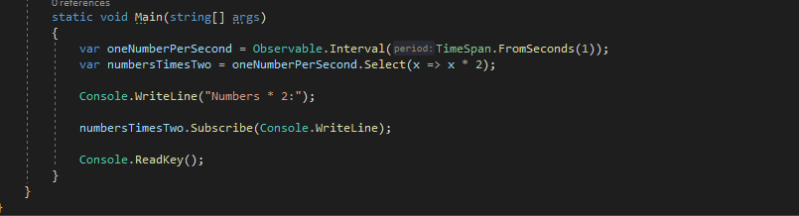
Observables are functors

Slide 18
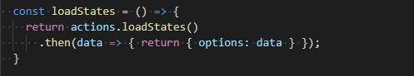
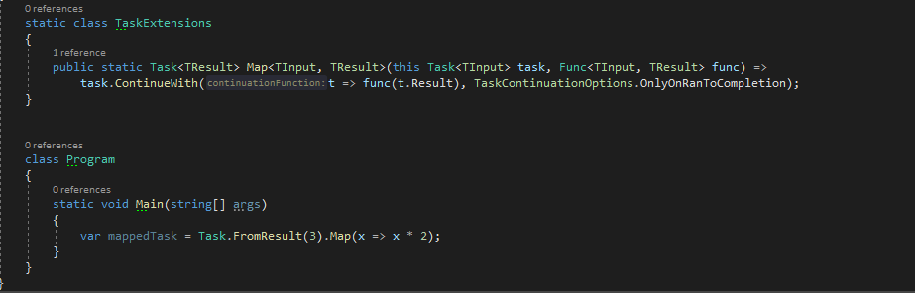
Tasks, promises, futures are functors

Slide 19


Slide 20
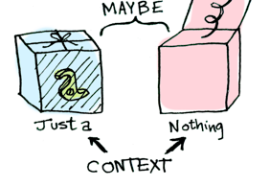
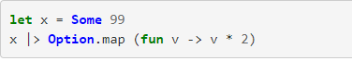
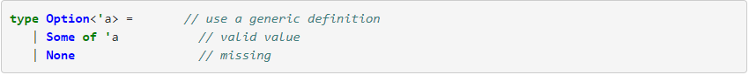
The option (maybe) functor

Slide 21
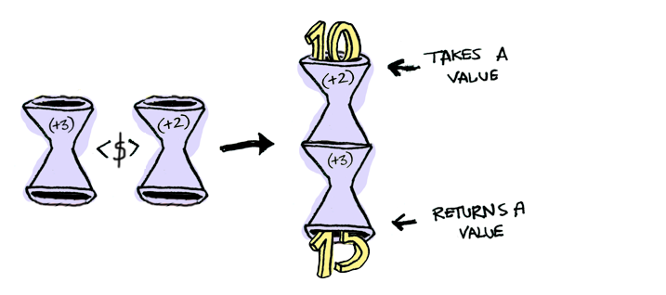
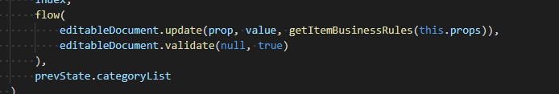
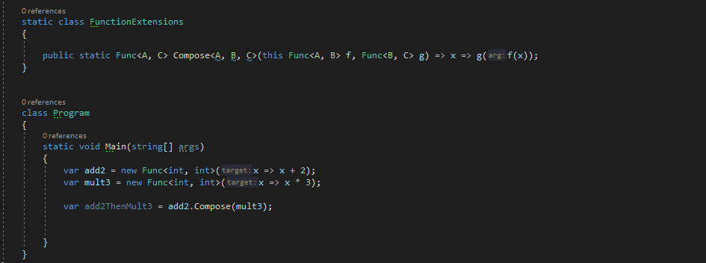
Functions (unary) are functors

Slide 22


Slide 23

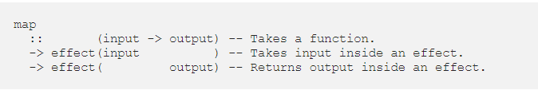
A functor is an effect that you can define map for

Slide 24
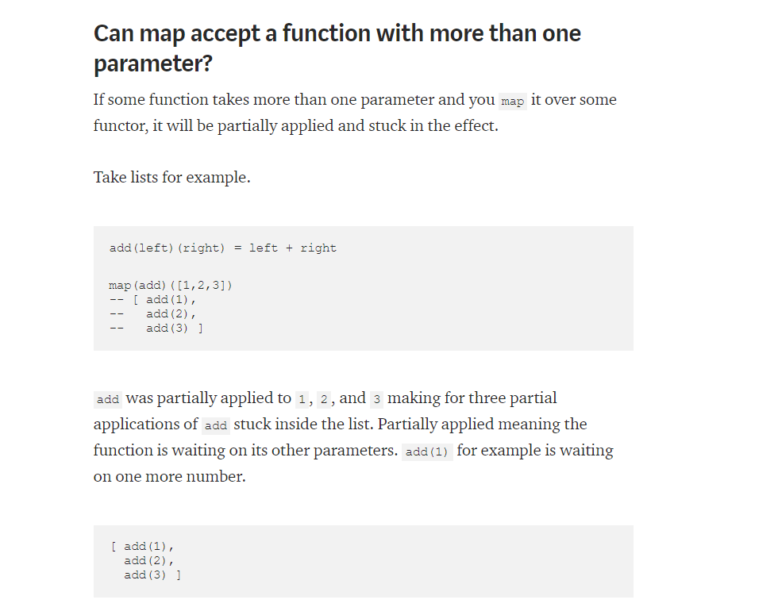

Slide 25
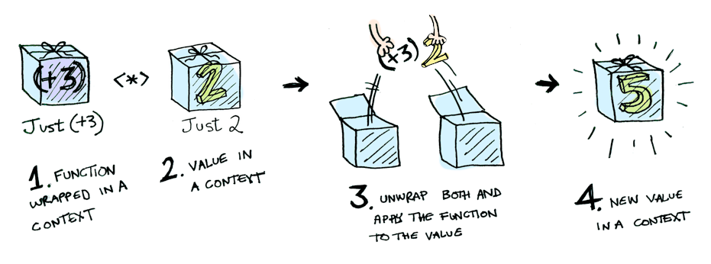
Applicative
They know how to lift (upgrade) n-ary functions

Slide 26


Slide 27
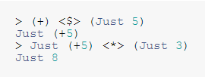

Slide 28
References
https://medium.com/javascript-scene/composing-software-the-book-f31c77fc3ddc
http://adit.io/posts/2013-04-17-functors,_applicatives,_and_monads_in_pictures.html
https://medium.com/@lettier/your-easy-guide-to-monads-applicatives-functors-862048d61610
https://www.techempower.com/benchmarks/#section=test&runid=a1843d12-6091-4780-92a6-a747fab77cb1&hw=ph&test=plaintext&l=hra0hp-1&p=zik0zj-zik0zj-zijocf-5m9r
https://github.com/giraffe-fsharp/Giraffe

